Slide 1
Supplies training
Bar Code Supplies
Christine Weber
April, 2015

Slide 2
Agenda
Customer Insights
Competition
Zebra Supplies Value
Key Questions/Objections
Value-Added Programs, Sales Tools and Resources

Slide 3
Customer insights
Understanding the Decision Makers, their Perceptions & Needs

Slide 4
Buying Center
Director of Regulatory Compliance and Quality
Needs:
-Barcode remains readable during the products life
-Label contains all required information
Engineering
Needs:
-Barcode remains readable during the products life
Product Marketing/ Management
Needs:
-Branding on label
-The use of color enables user to do their job more efficiently (i.e. highlight size, etc)
Labeling and Document Control
Needs:
-Label contains all required information
-Barcode remains readable during the products life
Materials Mgmt/ Purchasing
Needs:
-Reliable and consistent solutions at competitive prices
-Easy to do business with
Operations Manager
Needs:
-Reliable solutions that help alleviate and reduce burden on his current resources
-Reduce error rates
-Help implement best practices

Slide 5
Customer Perceptions & Needs
Perceptions
Labels are a commodity
There are little to no differences in performance
Needs
Partner that will provide a high level of service
High-Quality labels
Fast Delivery

Slide 6
The competition

Slide 7
Overview – Supplies Competitors
 | Strengths | Weaknesses
Local | Very close to customer Offer personalized service Competitive pricing | Minimal knowledge of thermal printers Do not pre-test materials Can’t offer free printheads Single location Business stability No R&D capabilities Quality processes
Regional | Fairly close to customers Multiple locations Competitive pricing Use automation to keep costs down | Minimal knowledge of thermal printers Do not pre-test materials Can’t offer free printheads Some R&D capabilities
National | Multiple locations Competitive pricing Use automation Wide range of manufacturing capabilities R & D capabilities | Minimal knowledge of thermal printers Do not pre-test materials Can’t offer free printheads
Printer Manufacturer | Intimate understanding of thermal printers Business stability R&D capabilities | Range of pre-tested materials

Slide 8
Genuine Zebra supplies
Value

Slide 9
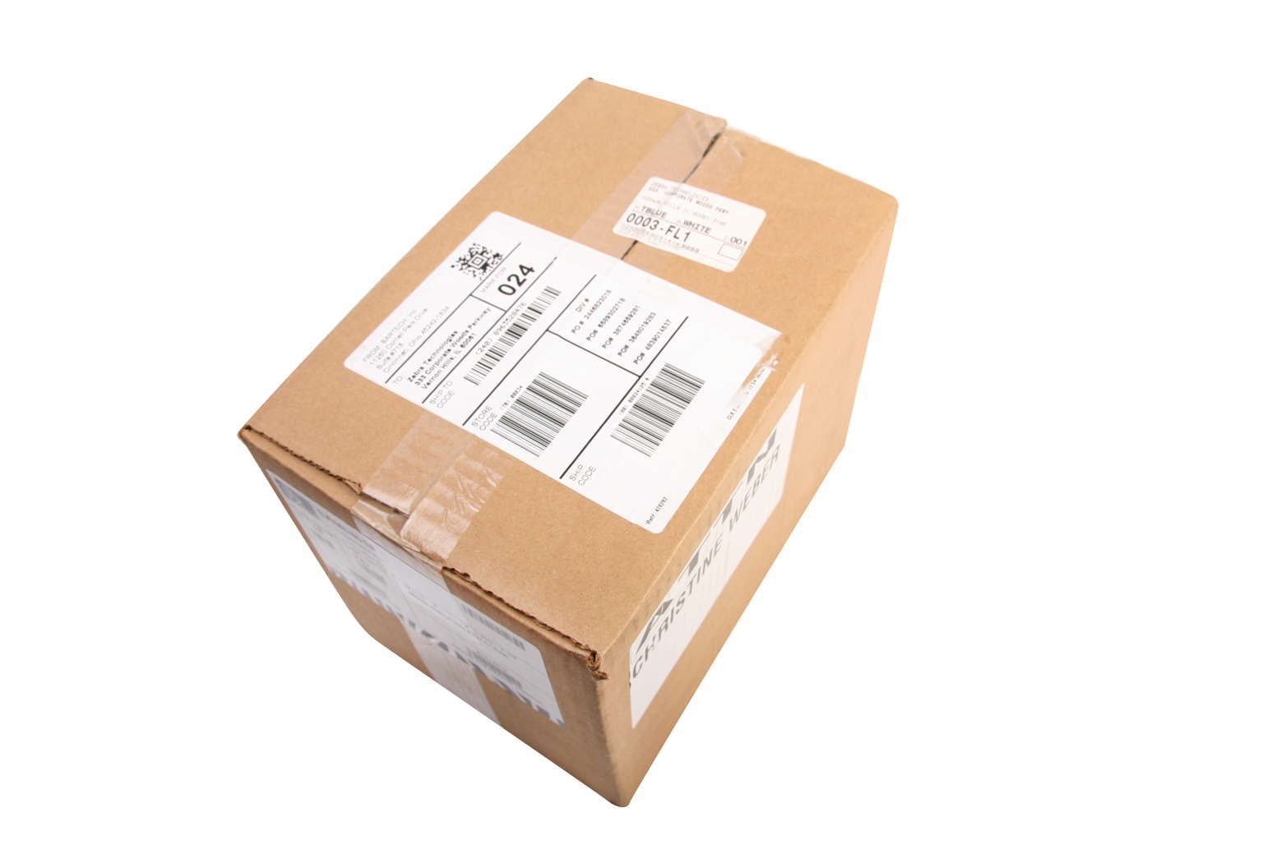
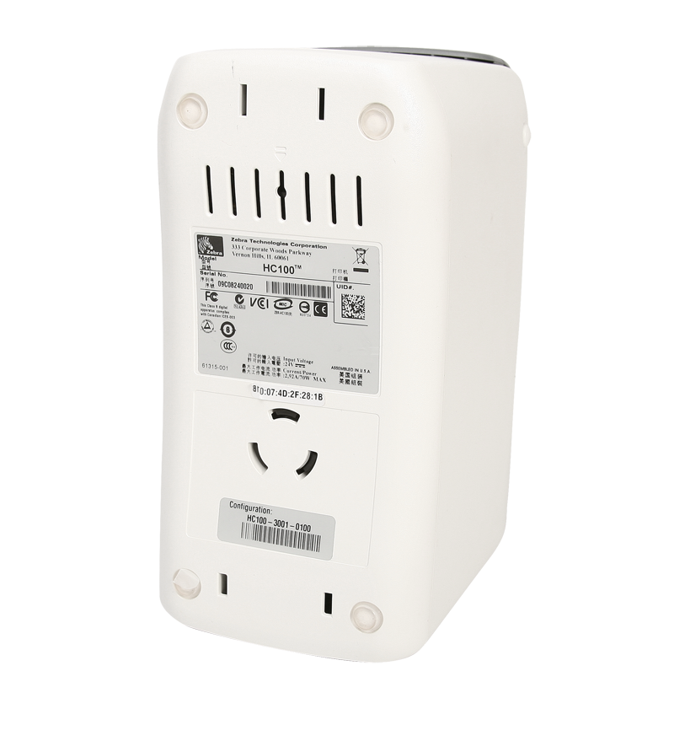
Barcode Label: A Critical Mechanism
Notes:
Whether you are identify a shipment or communicating a new price to a customer, a barcode label is a critical mechanism for your business

Slide 10
Barcode Label: A Critical Mechanism
Enhance Customer Experience
Improves Operational Efficiency
Supports Business Growth
Ensures Brand Consistency
Notes:
A barcode label helps enhance the customer experience, enables you to improve operational efficiency, supports the growth of your business and can even ensure brand consistency. They are the final link between your company and key stakeholders including customers and regulators.

Slide 11
A Barcode Label Seems Simple….
Topcoat
Facestock
Adhesive
Silicone Coating
Release Liner
Notes:
A barcode label seems simple – a label is a label right? Not exactly. The composition of a label includes many items that need to work together in your environment. The Release Liner and Silicone Coating are especially critical if you are utilizing an applicator to apply the label after being printed from a Print Engine. A standard adhesive sticks well to most items, but adhesive is critical in extreme temperatures and on rough surfaces. The facestock of a direct thermal material differs from supplier to supplier – specifically, the sensitivity which affects the darkness setting you use on the printer. The topcoat provides additional protection to the label.

Slide 12
Key Considerations
Application
Label Format
Printing
Lifespan
Indoor/Outdoor
Chemical Resistance
Abrasion Resistance
Extreme Temperatures
Print Speed
Print Darkness
Dots per Inch
Use of an Applicator
Surface
Notes:
There is a lot to consider when choosing the right label for an application. Not only do you have to consider your environment and the item being labeled, but your label format and printing requirements.
What happens if the labels aren’t right for the application or not of high-quality. You could experience:
-the need to re-print labels and service your printers more often
-reduced productivity and efficiency
-customer dissatisfaction
-increased IT calls as most people think the printer is the problem.

Slide 13
Effects of Low-Quality Labels
Unreadable Labels
Premature Printhead Failure
Need to Reprint Labels
Increased Down Time and Cost to Replace Printheads
Increased Printer Issue Calls to IT
Reduced Productivity and Efficiency
Inability to Meet Delivery Dates
Customer Dissatisfaction

Slide 14
Genuine Zebra Supplies
High-Quality. Pre-Tested. Reliable.
Notes:
That is why Zebra is focused on developing high-quality, pre-tested, reliable solutions that meet the needs of customer’s unique environments

Slide 15
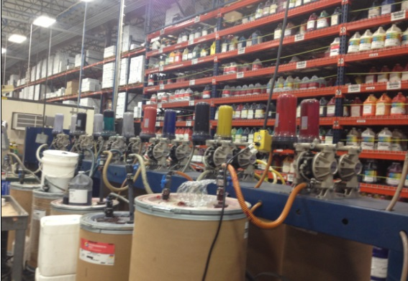
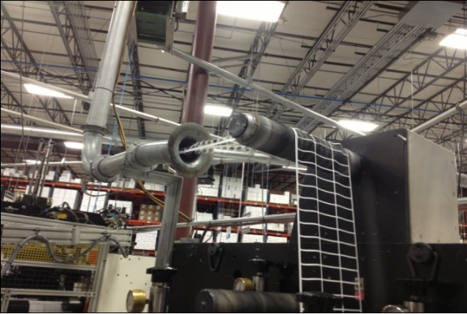
High-Quality Ensures Satisfaction
Pre-tested, consistent materials and quality processes ensure consistent print quality, reducing the need to re-print labels due to poor readability and scannability
Do not substitute materials
ISO 9001:2008 certified
Computerized vision inspection system
Color matching software and equipment

Slide 16
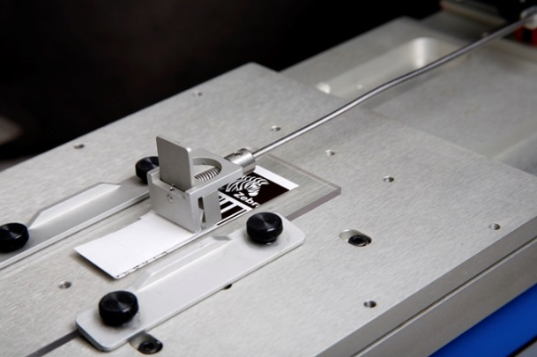
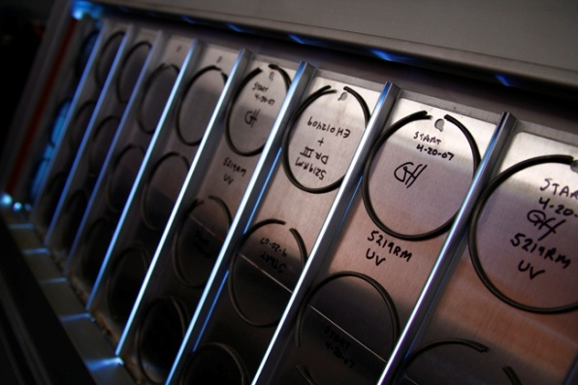
Pre-Tested Materials Maximizes Operations
Supplies Research and Development Team
Pre-tests all materials in Zebra printers
Printhead wear and tear
Verifies adhesive strength specifications
Pre-tests based on different environments:
Indoor/Outdoor
Low/High Temperatures
Abrasion
Chemicals

Slide 17
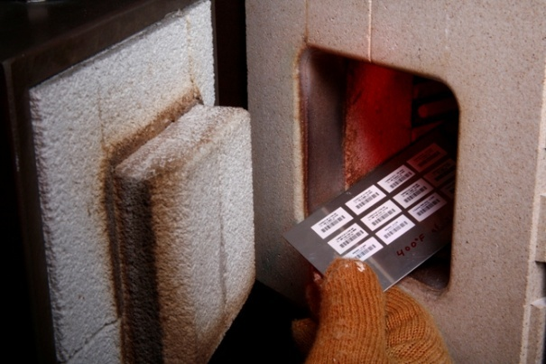
Unique Solutions for Unique Applications
Supplies R&D Functions:
Product Design
Special shape
Security features
Tamper-evident slits
Perforations
Laminates
Application assistance and testing
Accelerated outdoor life
Image abrasion/durability
Adhesion & tear strength
Harsh chemicals
Regulatory Assistance: UL, cUL, CSA
Compliance Assistance: ROHS, REACH, UID, IMDS
Muffle Furnace
Weathering Machine

Slide 18
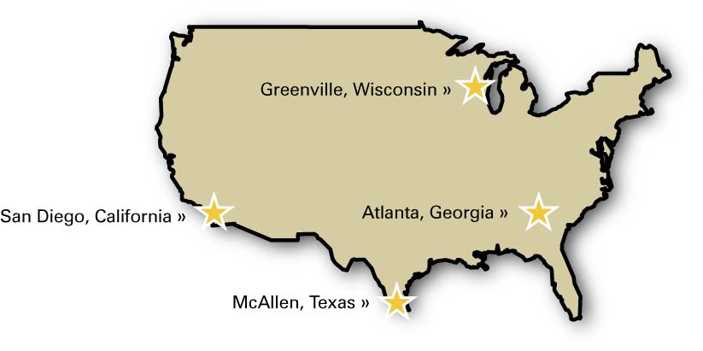
Reliability Means Your Business Stays Up and Running
One of the largest thermal convertors in North America
Extensive Manufacturing Capabilities & Automation
Quick Delivery
Contingency/Disaster Plan

Slide 19
Key Questions
Identifying Opportunities & Overcoming Objections

Slide 20
Key Questions - Manufacturing
Labeling Process
Walk me through the labeling process.
Current Labels
Look inside the core to try to identify the convertor.
Are the cores “sealed”?
Do you feel and/or see dust when you touch the roll of labels?
Request 5 samples of each label, preferably printed. Remember to notate the application on each label.
View printed labels to identify any print quality issues.
Scratch label to validate any print durability issues.
Look inside the core to try to identify the convertor.
Printer
What printers are being used?
Is there dust built up within the printer?
Is it done on the floor on in a "labeling room"?
How do they verify print quality? Vision system? Online verification system?
Where are they storing their labels?
Can we conduct a site survey?

Slide 21
Key Questions - Manufacturing
Quality
What is your Quality Process?
Challenges and Business Pains
What is the label rejection rate?
Purchasing
Are they purchasing from multiple Suppliers?
If yes, who and why are they purchasing from multiple suppliers?
What are the exact specifications for each of the labels they are using?
Is print quality or durability ever an issue?
Identify opportunities to use color-coding to reduce errors or increase accuracy.
What are your Quality Requirements/Specifications?
What are your Quality Qualifications?
How do you know that what you are buying is meeting your spec?

Slide 22
Common Objections
We already have a supplier
Buying Zebra Supplies for your Zebra printer ensures you receive a high-quality solution, maximizing up-time. Zebra extensively tests all materials in Zebra printers. Testing includes:
Zebra Supplies are more expensive
Zebra utilizes the highest quality of materials that are pre-tested in Zebra printers.
Print quality
Adhesive strength
Chemical, abrasion resistance
Printhead wear and tear
We never substitute materials so the performance will be consistent from run-to-run.
How many printheads do you replace annually?
What if more expensive, meant reduced operational costs due to decreased downtime and increased productivity?
If you decide to exclusively use Zebra Supplies you are eligible for our Printhead Protection Program, which offers you free replacement printheads.
Notes:
Your supplies are more expensive
We utilize the highest quality of materials that are pre-tested in Zebra printers.
We never substitute materials so the performance will be consistent from run-to-run.
Why do I need XXXX certified labels?

Slide 23
Value-added programs, Tools & resources
Make it Easy to Sell Supplies

Slide 24
Supplies Excel Price List on IN

Slide 25
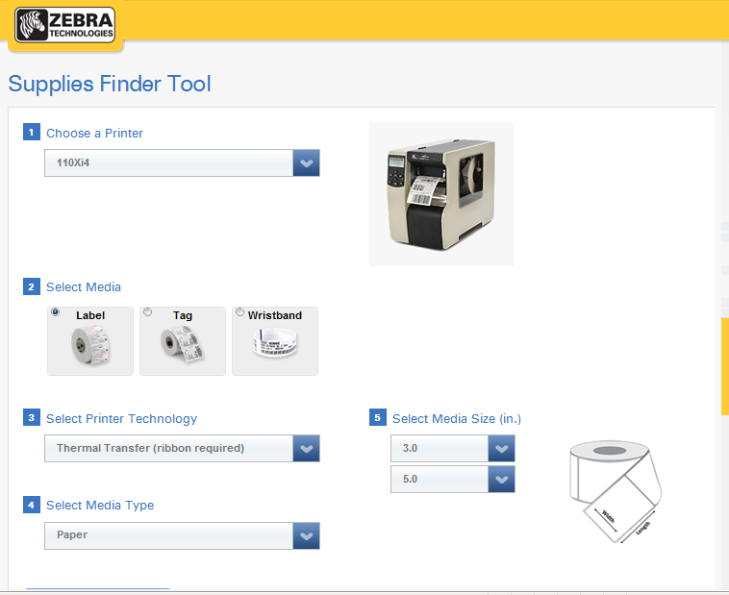
Supplies Product Finder – Locate ZipShip Items Quickly
https://www.zebra.com/us/en/supply-selector-tool.html

Slide 26
Inventory Management Solutions Lock in Business and Provide Lower Pricing
Order Options | Shipment | Term of Commitment | Pricing | Purchase Order | Additonal Financial Commitment | Limitations | Formal Agreement Required
Standard Custom Quote | Subject to manufacturing lead time | Quote good for 3 months | Subject to quantity breaks; Quantity on quote must match PO | Order by Order | None | Subject to standard $250 per order line minimum | PO
Blanket | On date scheduled when order entered | No more than 6 months without approval from Sales Management | Fixed --- not subject to price increase | Total Order | Must take shipments/billings per timing in original order; if cancelled, prior shipments will be rebilled at price appropriate to lower total order quantity. | $250 per release minimum; maximum of 6 releases; 12 roll/pack minimum per order line per destination | No - Blanket PO serves as agreement
Make & Hold Agreement (MH/...) | 1st shipped at lead time after receipt of signed agreement; thereafter same or next business day after receipt of order | 3, 4, 5 or 6 months | Fixed --- not subject to price increase | Total Order | Must take shipment on any product which remains in Zebra inventory at end of the term of the agreement. | $1,000 minimum per item per month; maximum of 4 releases per month | Legal Agreement must be signed
Inventory Management Program (IMP/…) | 1st shipped at lead time after receipt of signed agreement; thereafter same or next business day after receipt of order | 12 months or more | Fixed but subject to price increase with 30 days notice | Order by Order | Must take shipment of inventory on hand up to agreed inventory maximum upon termination of agreement. | $25,000 minimum per item or $50,000 minimum per opportunity with $2000 or 72 roll minimum per item whichever is higher | Legal Agreement must be signed

Slide 27
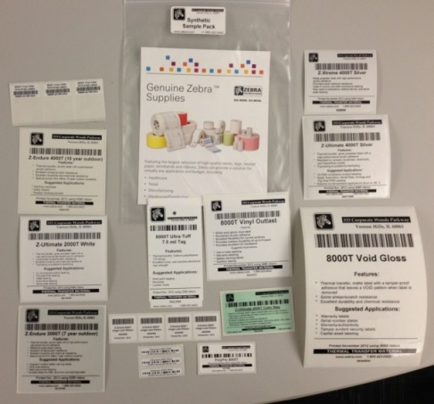
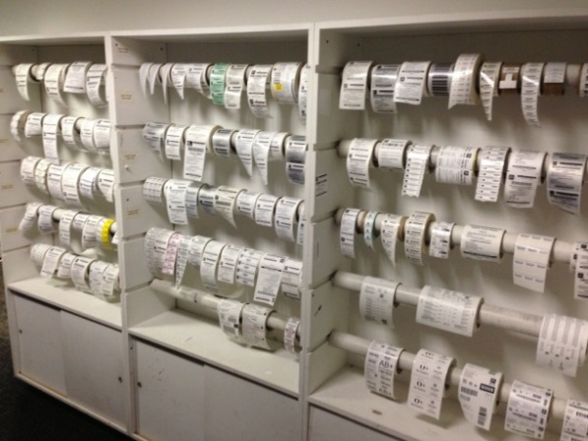
ZipShip Sample Program
Sample Options | To Be User When Customer Needs To…. | Request Process
Pre-Printed Strip of Material | Check Adhesive, Thickness, Color and Image Durability | Sales Specialist
Sample Pack | See a variety of materials | Sales Specialist
SAM Roll | Print on the material. This is a small roll of labels | Partner Can Order or Process FOC Order
ZipShip Roll | Customer can test in their Application12 ips | Partner Can Order or Process FOC Order

Slide 28
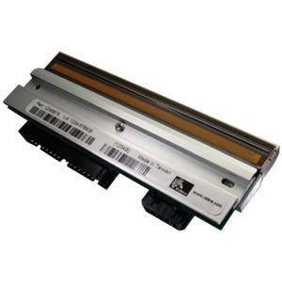
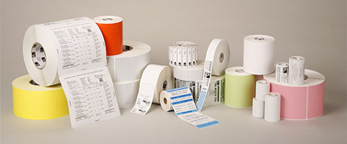
Printhead Protection Program
Gain more supplies business by offering free printhead replacements to end users who agree to use Zebra supplies exclusively
Supplies profit > printhead profit
Media deals can be won at higher margins
Blocks out the competition
Positions Zebra as a total solutions provider
Only use when customers require an added incentive
Exclusive supplies usage
Free printheads
=

Slide 29
Eligibility and Enrollment
No minimum supplies commitment
Tabletop and desktop printers
One year agreement
Enrollment & Printhead request forms
Located on Access Zebra
30 day waiting period once enrolled
Replacement Printhead sent to end user
Email all completed documents to printheadprotection@zebra.com.

Slide 30
Printhead Protection Calculator
Located at: http://phc.zebra.com/
Notes:
-Calculates annual Supplies and Printhead expenditures.
-Automatically brings in the descriptions and list pricing for ZipShip Supplies and Printheads.
-Enables the addition of Custom item information.
-Calculates the number of Printheads the customer will utilize annually based on the label volume and material (direct thermal/thermal transfer), as well as printer type (industrial/desktop).
-Enables the modification of Pricing and the number of Printheads.
-Creates a PDF proposal for customers, including the Printhead Protection brochure and enrollment form.

Slide 31
Printhead Protection Use Case
Manufacturer of accessories for handheld electronic devices
Printers: 110xi4 and 220xi4
Supplies (annual): $100K
Printheads (annual): 15 with annual value* of $11K
*Based on printhead list price
Notes:
Zebra is dedicated to making sure we deliver not just a printer, but a whole solution that works seamlessly together as we did with this customer.

Slide 32
New! Rapid Quote Tool Quote Specification Parameters
Ability to Quote New Items
Sizes | Perf | Printer | Colors | Material | Plant
4 x 8 | Perf | Desktop | 0 | Z-Perform 2000T | WI
4 x 6.5 | No Perf | Industrial | 1 | Z-Perform 2000D | GA
4 x 6 |  |  | 2 | Z-Ultimate 2000T | TX
4 x 4 |  |  |  | PolyPro 3000T | CA
4 x 3
4 x 2.5
4 x 2
4 x 1
3 x 5
3 x 3
3 x 2
3 x 1
2.25 x 1.25
2 x 1.25
2 x 1
1.5 x 1

Slide 33
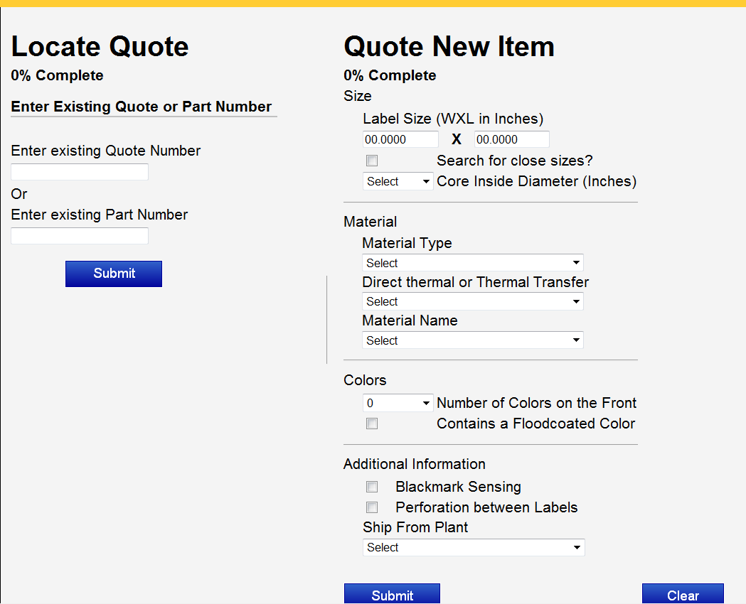
New! Rapid Quote Tool New Home Screen

Slide 34
Questions

